Slide 1
PROTEUS
A Prospective Randomised Controlled Trial Evaluating The Use Of Artificial Intelligence in Stress Echocardiography
Dr Ross Upton PhD
On behalf of the PROTEUS Trial Investigators
Monday 2nd September 2024

Slide 2
Background
Artificial intelligence (AI) applied to cardiovascular imaging, has been proposed to augment clinical decision-making
However, none have been evaluated in a multi-center, prospective randomized controlled trial that examines impact on patient care pathway outcomes
PROTEUS was designed to test, in real-world practice, whether AI interpretation of stress echocardiography augments clinician selection of patients for angiography

Slide 3
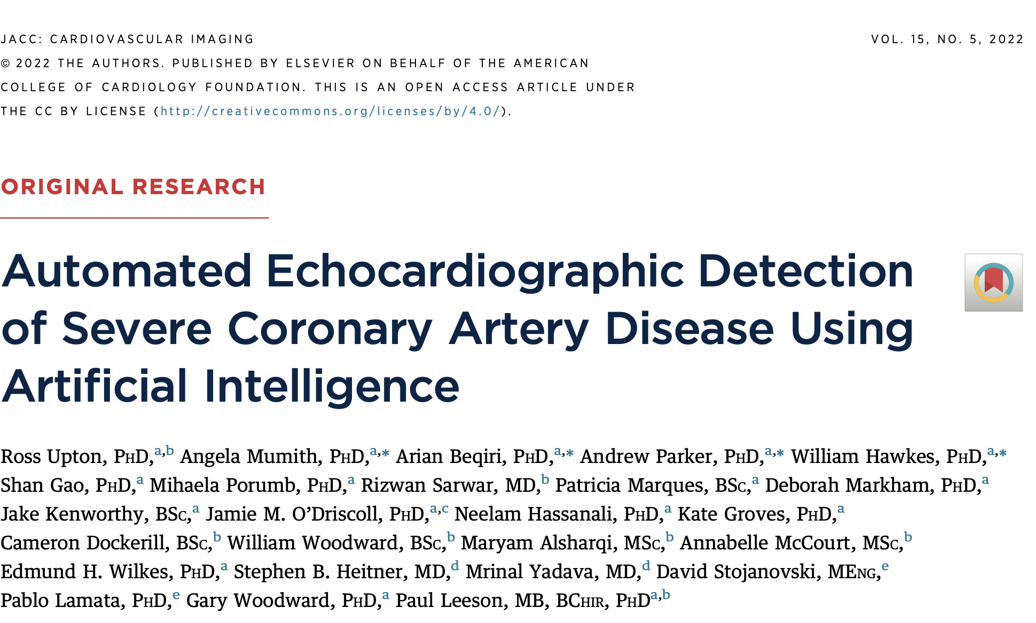
Background
In coronary artery disease, clinicians rely on non-invasive imaging to identify disease and select a management approach
Stress echo is one of the most common tests but relies on visual qualitative assessment
Previously, we reported the development of an AI device trained to identify patients with severe coronary artery disease from stress echo images

Slide 4
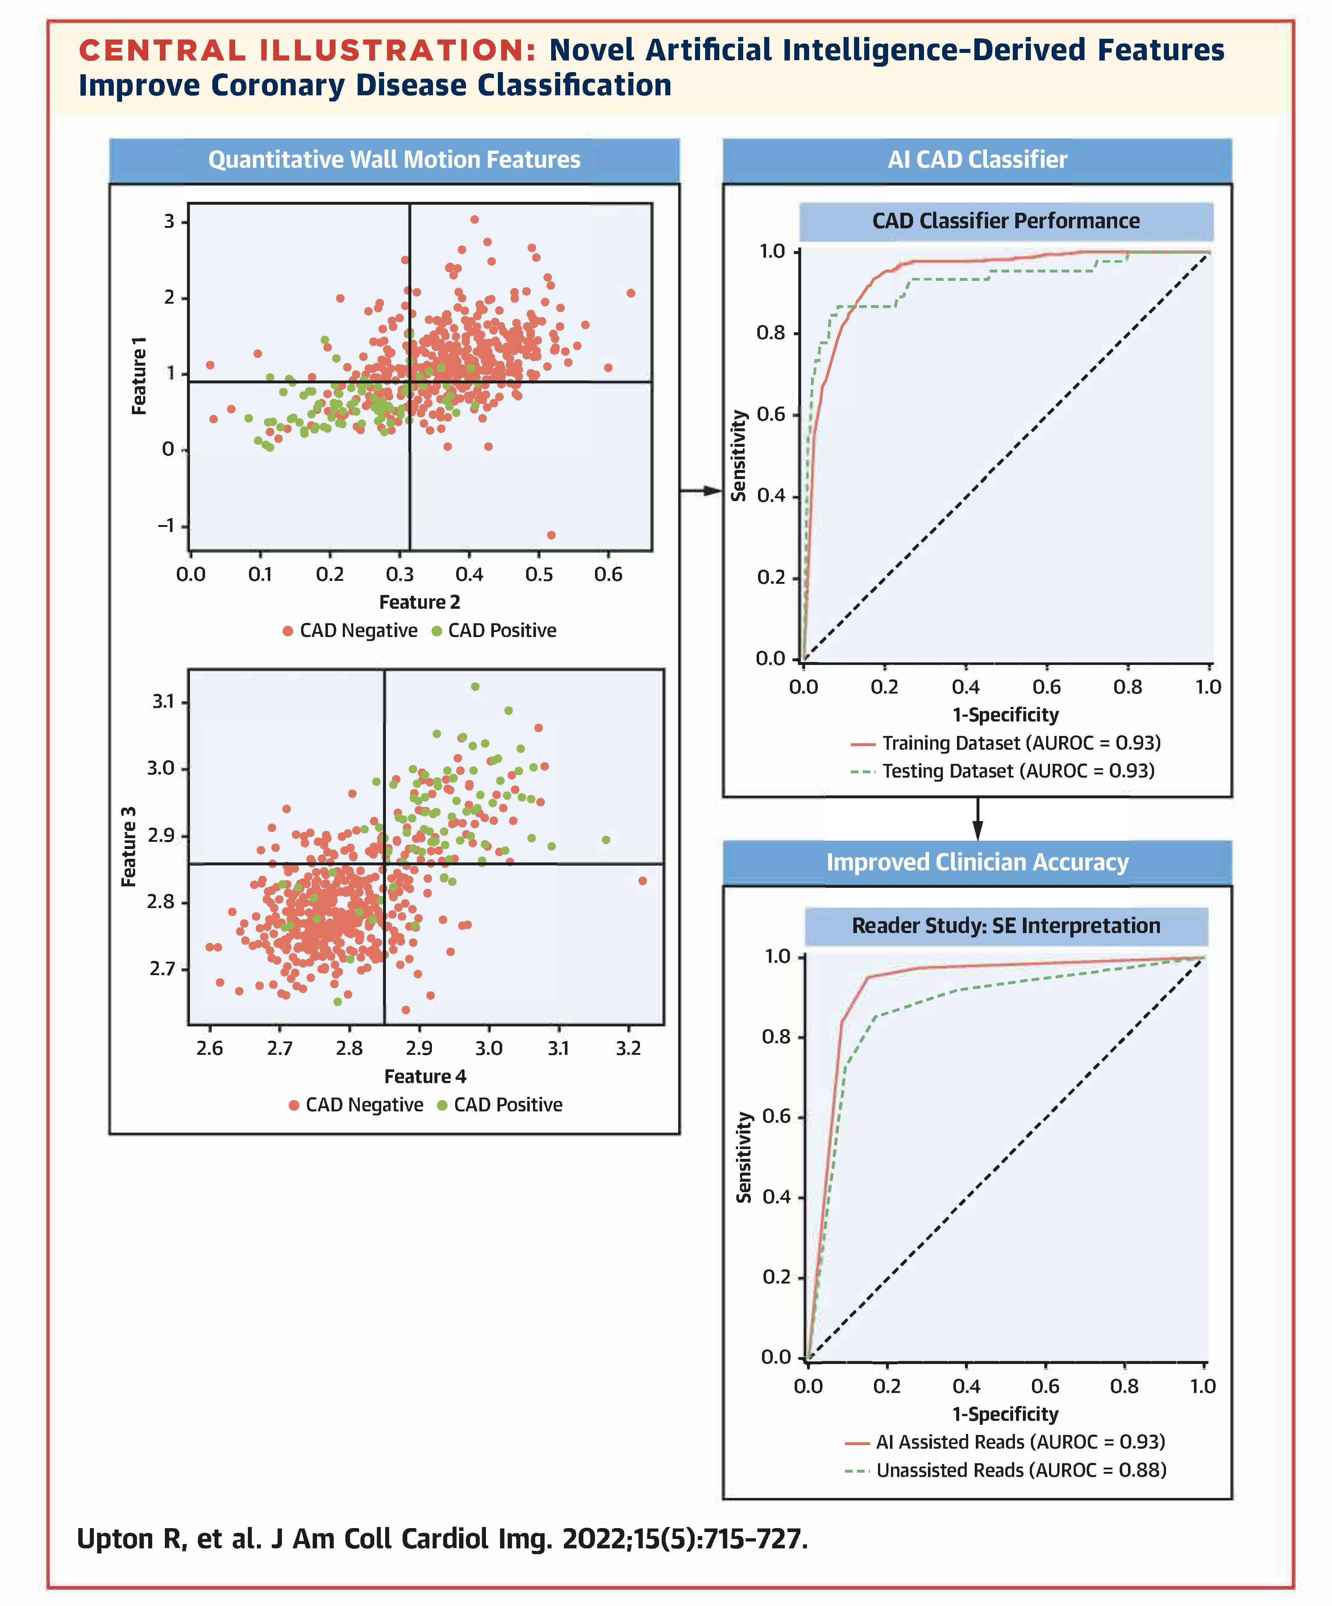
Background
The AI device is a supervised machine learning classifier utilizing novel geometric features that capture LV motion between rest and stress
The AI device demonstrated excellent performance and improved less experienced clinicians to the level of expert clinicians in a reader study

Slide 5
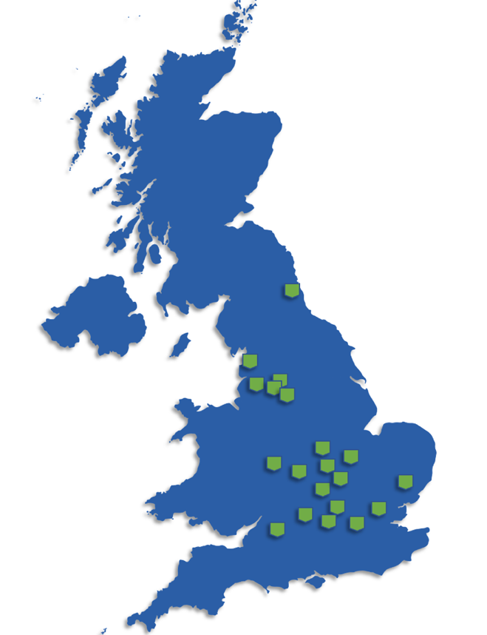
Methods – Study Design and Participants
PROTEUS was a multi-center, randomized controlled trial in adults undergoing a clinically indicated stress echocardiogram to assess inducible ischemia from 20 NHS sites across the UK
Inclusion Criteria:
Adult males and females referred for a stress echo for investigation of ischemic heart disease
Exclusion criteria:
(i) patients with more than moderate valvular heart disease
(ii) left ventricular outflow tract obstruction
(iii) significant co-morbidities with expected life-expectancy of under 12 months
(iv) previous coronary artery bypass graft or other cardiac surgery
(v) congenital or inherited myocardial disease

Slide 6
Methods – Randomization and Procedures
Patients were randomly assigned to either standard decision-making (Control), or AI-augmented decision-making (Intervention)
Patients in Control underwent stress echocardiography per local healthcare protocols
Patients in Intervention also underwent stress echocardiography, but images were sent for additional assessment by the AI device

Slide 7
Methods – Endpoints
All patients were followed up for six-months after stress echocardiography and their record adjudicated by a committee of cardiologists
Primary endpoint
Evidence of severe coronary disease in patients referred for angiography following stress echo or evidence of an event within six-months
Testing non-inferiority of clinician decision (AUROC) in Intervention compared to Control
Non-inferiority was accepted when the lower bound of the 95% confidence interval of the AUROC difference between Intervention and Control did not surpass -0.05
Secondary analyses examined non-inferiority in pre-specified subgroups where interpretation is known to be more challenging

Slide 8
Results – Baseline Characteristics
Characteristic | Control (N= 1175) | Intervention (N= 1166)
Female (%) | 503 (45.40) | 493 (44.62)
Age – years (IQR) | 63.47 (12.24) | 63.88 (12.01)
BMI – kg/m² (IQR) | 28.83 (5.89) | 28.75 (5.64)
White (%) | 786 (70.94) | 797 (72.13)
Black, Asian or undefined (%) | 322 (29.05) | 308 (27.87)
Current smoker (%) | 122 (11.01) | 112 (10.14)
Ex-smoker (%) | 444 (40.07) | 438 (39.64)
Hypertension (%) | 581 (52.44) | 577 (52.22)
Hypercholesterolemia (%) | 490 (44.22) | 475 (42.99)
Diabetes Mellitus (%) | 212 (19.13) | 211 (19.10)
Peripheral Vascular Disease (%) | 29 (2.62) | 27 (2.44)
Pre-existing CAD (%) | 217 (19.58) | 213 (19.28)
Previous MI (%) | 63 (5.69) | 66 (5.97)
Previous PCI (%) | 83 (7.49) | 70 (6.33)
A total of 4,907 patients were screened at 20 NHS centres
1,175 patients were randomized to Control and 1,166 to Intervention
Groups were well matched for demographics and cardiovascular disease history

Slide 9
Results – Stress Echo Characteristics
Characteristic | Control | Intervention
Type of SE
Dobutamine (%) | 821 (74.10) | 808 (73.12)
Additional atropine (%) | 448 (40.30) | 431 (39.00)
Exercise (%) | 287 (25.90) | 297 (26.88)
Contrast Used
Yes (%) | 838 (75.63) | 818 (74.03)
Heart Rate
Resting – beats/min (IQR) | 76.26 (14.24) | 76.67 (13.82)
Stress – beats/min (IQR) | 139.39 (13.73) | 139.41 (14.11)
Systolic Blood Pressure
Resting – mmHg (IQR) | 146.74 (22.82) | 145.58 (23.61)
Stress – mmHg (IQR) | 153.63 (29.83) | 153.35 (29.30)
Resting RWMA
Yes (%) | 102 (9.21) | 81 (7.33)
Dobutamine was the most common stressor used
Three-quarters of patients received contrast
Less than one in ten had resting wall motion abnormalities

Slide 10
Results – Primary End Point
Group | Control | Intervention | Difference
AUROC (95% CI) | 0.55 (0.33, 0.80) | 0.63 (0.43, 0.83) | 0.09 (-0.22, 0. 39)
True Positives | 27 | 34
True Negatives | 1050 | 1037
False Positives | 9 | 15
False Negatives | 22 | 19
Sensitivity (95% CI) | 55.1 (43.74, 84.22) | 64.15 (33.33, 80.02) | 9.05 (-21.8, 39.59)
Specificity (95% CI) | 99.15 (97.16, 99.53) | 98.57 (98.09, 99.77) | -0.58 (-2.13, 0.94)
NPV (95% CI) | 98.0 (96.9, 99.3) | 98.2 (96.5, 99.3) | 0.25 (-1.66, 1.93)
PPV (95% CI) | 75.0 (50.0, 90.0) | 69.3 (50.00, 94.45) | -5.6 (-37.59, 24.44)
Intervention arm did not meet the pre-specified non-inferiority criteria, as the lower bound of the 95% confidence interval surpassed -0.05

Slide 11
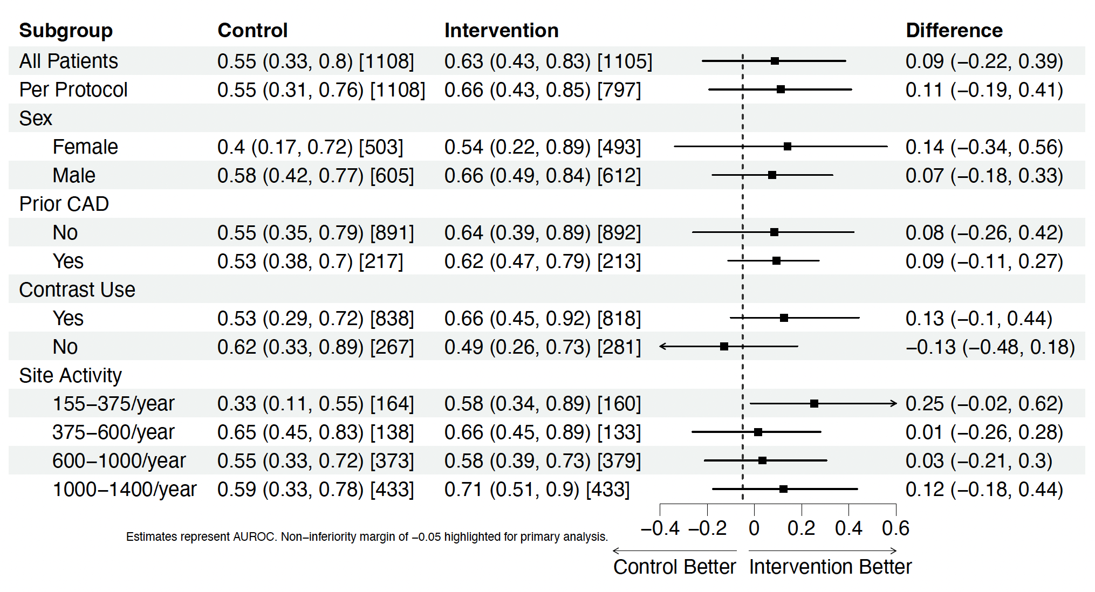
Results – Subgroups
Intervention arm met the pre-specified non-inferiority criteria in low volume stress echo centers

Slide 12
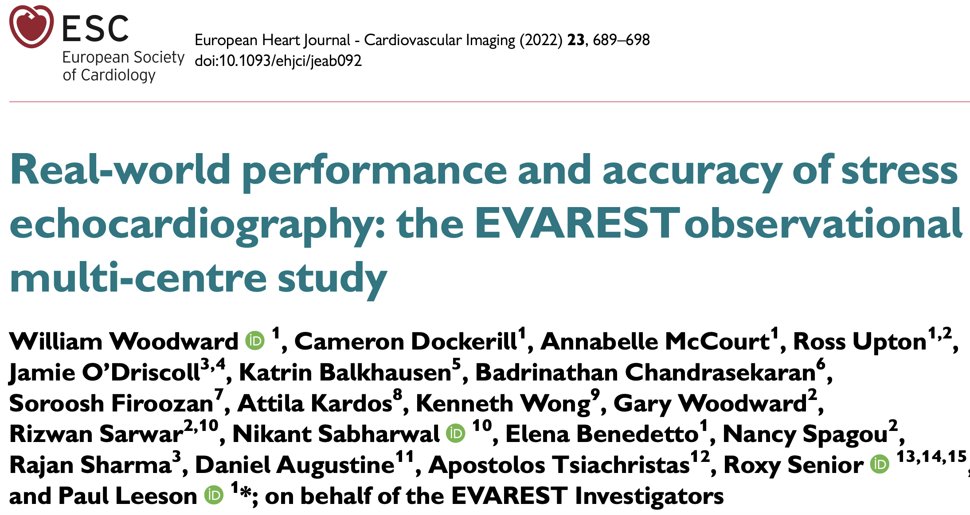
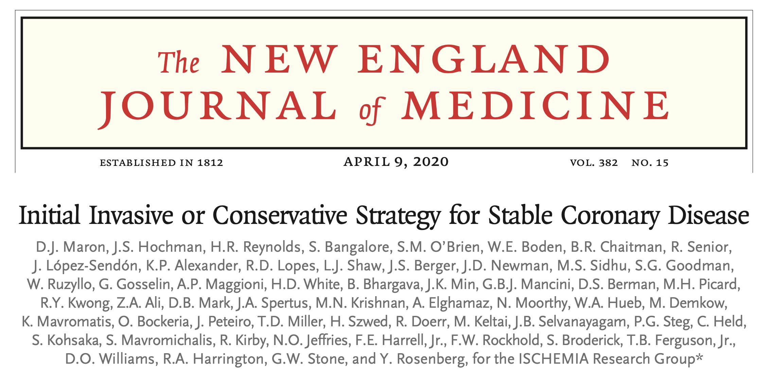
Discussion
The trial did not meet its primary end point, most likely due to the low angiography referral rate
It was powered on data from the EVAREST observational study of stress echo practice within the NHS
EVAREST recruited ~10,000 patients between 2009 and 2020 and ~15% of the target population were referred for angiography
Within PROTEUS the referral rate was only ~8%.
One potential driver for this drop in angiography referral may be recent large-scale randomized trials demonstrating non-inferiority of medical therapy

Slide 13
Discussion
Despite the low number of angiography referrals, the results indicate AI-Augmentation may have utility in low volume stress echocardiography centers
Clinicians who perform fewer stress echocardiograms a year, may have less opportunity to maintain level of expertise
These findings are supported by data in a previous reader study (Upton et al. 2022) demonstrating that AI-augmentation improved the lowest performing operators, increasing accuracy to a level consistent with the highest performing operators
These hypothesis-generating results should inform further trials, identify, and develop areas in the patient care pathway which might benefit from AI

Slide 14
Conclusion
This is the first prospective, multi-center, randomized controlled trial for an AI device in cardiovascular imaging, examining the impact on patient care pathway outcomes
AI-augmentation did not meet the pre-specified non-inferiority end point for appropriate referral to angiography compared to standard decision-making, driven by a lower-than-expected angiography referral rate
However, AI-augmented decision making may aid clinicians performing stress echocardiography in low volume centers

Slide 15
Acknowledgements
With thanks to all patients and trial investigators
Funders:
Accelerated Access Collaborative (ACC)
NHSx
Sponsor:
Ultromics Ltd.
Key Collaborators:
Cardiovascular Clinical Research Facility, University of Oxford
National Institute for Health Research, UK
Academic Health Sciences Network, Oxford
PROTEUS Co-Authors and TSC
PROTEUS Trial Sites:
Wrightington, Wigan and Leigh NHS Foundation Trust
Stockport NHS Foundation Trust
St George's University Hospitals NHS Foundation Trust
Northern Care Alliance NHS Foundation Trust (Oldham)
Northern Care Alliance NHS Foundation Trust (Salford)
Royal United Hospitals Bath NHS Foundation Trust
Oxford University Hospitals NHS Foundation Trust
Northumbria Healthcare NHS Foundation Trust
Buckinghamshire Healthcare NHS Trust
University Hospitals of Leicester NHS Trust
East Suffolk and North Essex NHS Foundation Trust
Blackpool Teaching Hospitals NHS Foundation Trust
Royal Berkshire NHS Foundation Trust
Northampton General Hospital NHS Trust
University Hospitals Birmingham NHS Foundation Trust
University Hospitals Coventry and Warwickshire NHS Trust
North West Anglia NHS Foundation Trust
Mid and South Essex NHS Foundation Trust
Milton Keynes University Hospital NHS Foundation Trust
Great Western Hospital NHS Foundation Trust

Slide 16
Publication – In Press
PROTEUS: A Prospective Randomised Controlled Trial Evaluating The Use Of Artificial Intelligence in Stress Echocardiography
Ross Upton, PhD^{1,2}; Ashley P Akerman, PhD²; Thomas H Marwick, MBBS, PhD, MPH, TSC chair³; Casey L Johnson, MSc¹; Hania Piotrowska, BA²; Mamta Bajre MBBS⁴; Maria Breen, PhD²; Helen Dawes, PhD⁵; Hakim-Moulay Dehbi, PhD⁶; Tine Descamps, PhD²; Victoria Harris, PhD, DSMC⁷; Will Hawkes, PhD²; Samuel Krasner, BA¹; Emily Sanderson, MSc²; Natalie Savage, PhD¹; Ben Thompson, PhD²; Victoria Williamson, PhD⁸; William Woodward, BSc¹; Rizwan Sarwar, MRCP²; Jamie O’Driscoll, PhD^{9,10}; Rajan Sharma, MD¹⁰; Virginia Chiocchia, PhD, DSMC¹¹; Steffen E Petersen, MD, DSMC^{12,13}; Elena Frangou, PhD, TSC¹⁴; Ged Ridgway, PhD, TSC¹⁵; Sanjeev Bhattacharyya, MD, TSC¹²; David P Ripley, PhD, TSC¹⁶; Gary Woodward, PhD²*; Paul Leeson, MB, PhD^{1,2}* on behalf of the PROTEUS Investigators

